Slide 3
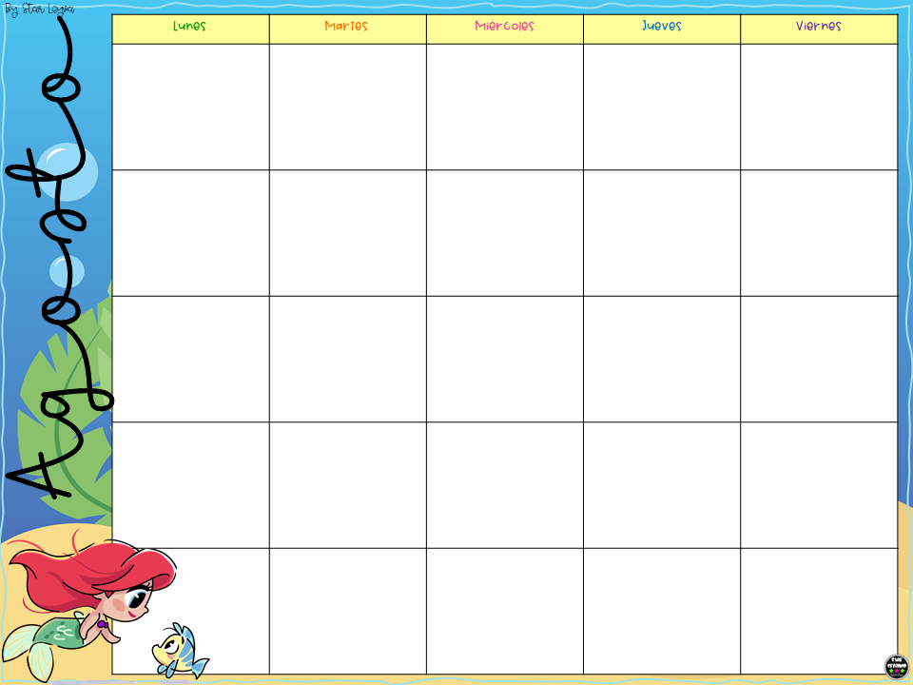

Slide 40
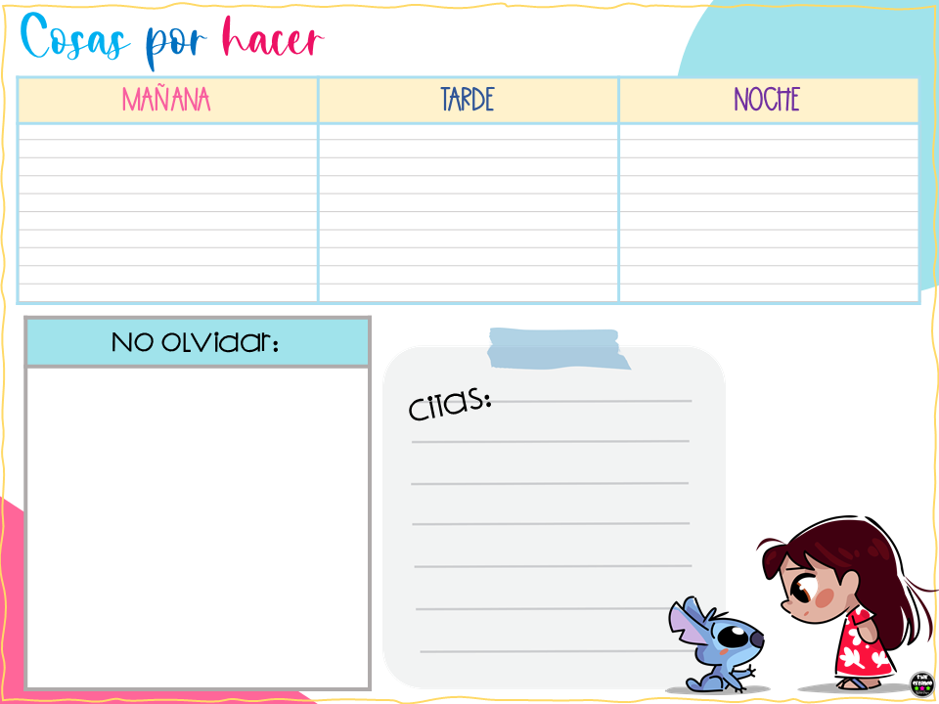

Slide 50
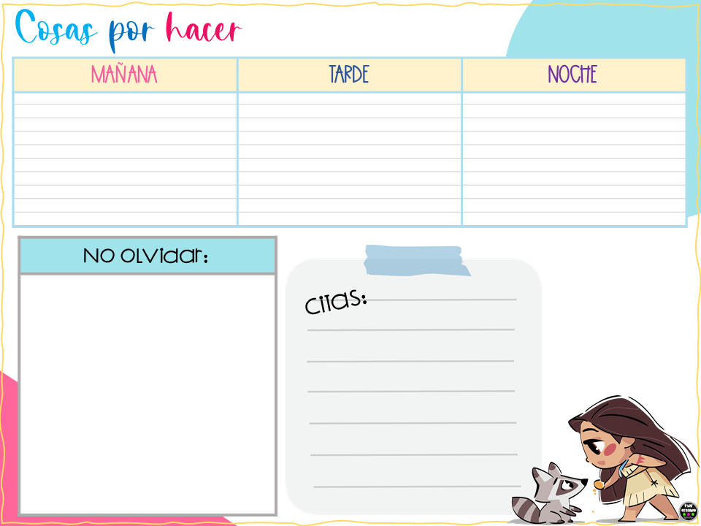

Slide 53
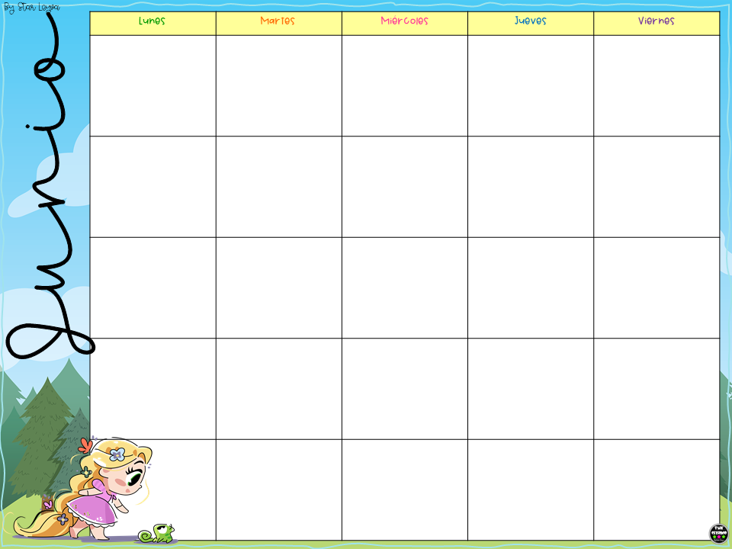

Slide 62
https://www.facebook.com/Star-Creando-Star-Leyva-464169540446644/

